Slide 1


Leave Management System
DA 214 Course Project
Roll no.: 220150010

Slide 2

PROBLEM STATEMENT:
Create a Leave Management system project, where students can apply for leaves which can be approved/rejected by course instructors.
The project should include a functional backend and frontend for easy user interaction.
Some necessary features:
Students should be able to select dates and apply for leaves with reasons.
Students should be able to view their leaves and their status.
Instructors should be able to accept or reject a leave by looking at it’s details.
Both students and instructors must be able to view their own profile.
Login, signup and authentication must be implemented for both students and instructors.

Slide 3



FEATURES:
Student side
Instructor side

Slide 4
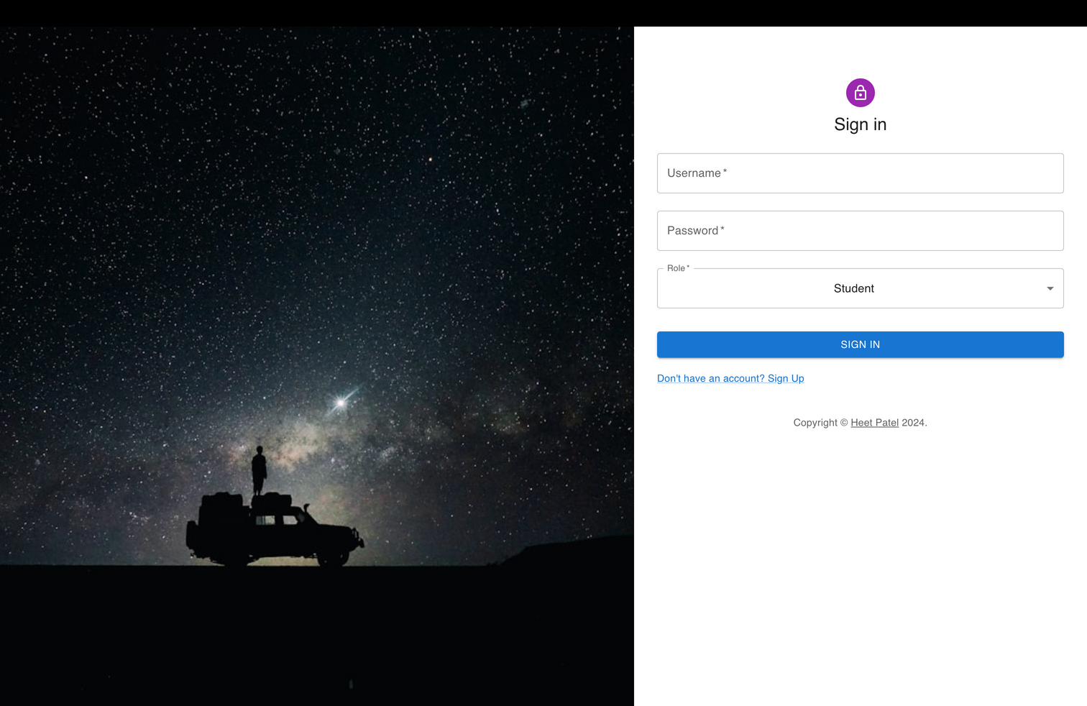
SIGN
IN
This is a basic
sign in page for the users.
You can enter your credentials and select role.
There is also a link to the signup page.

Slide 5
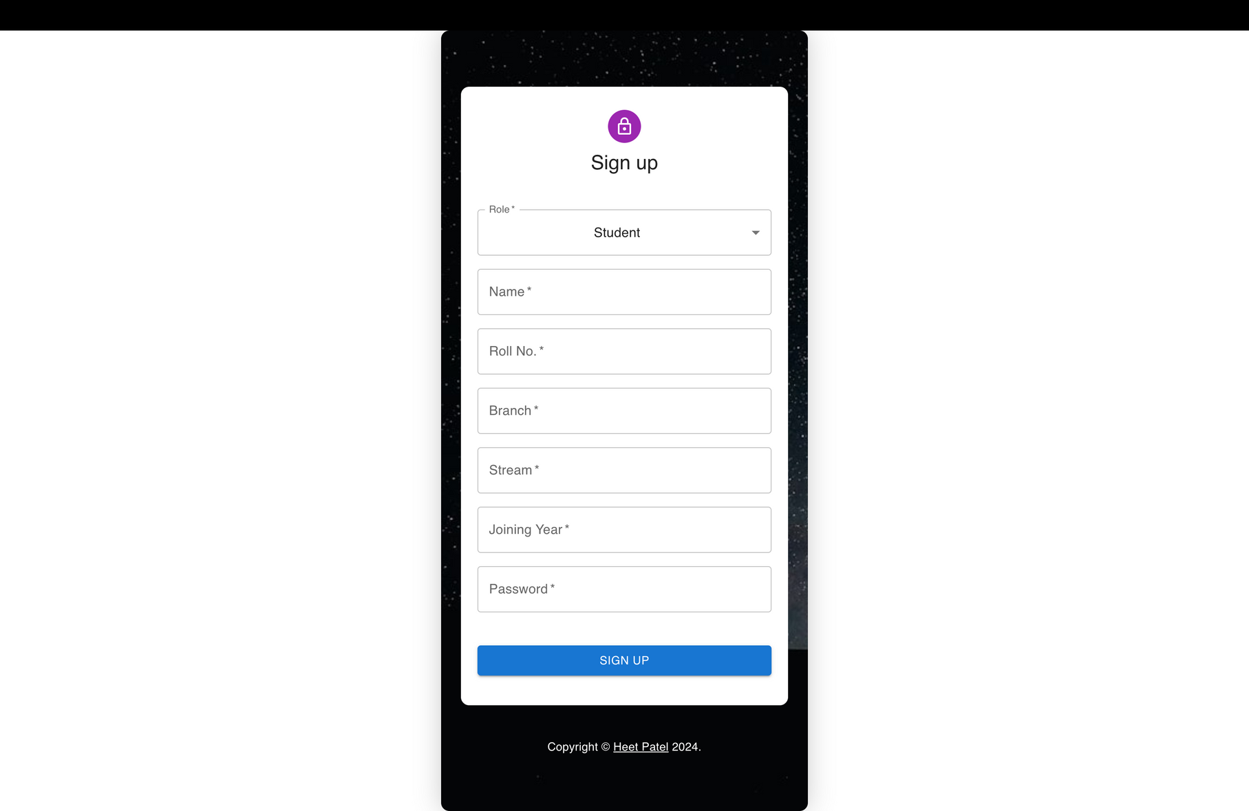
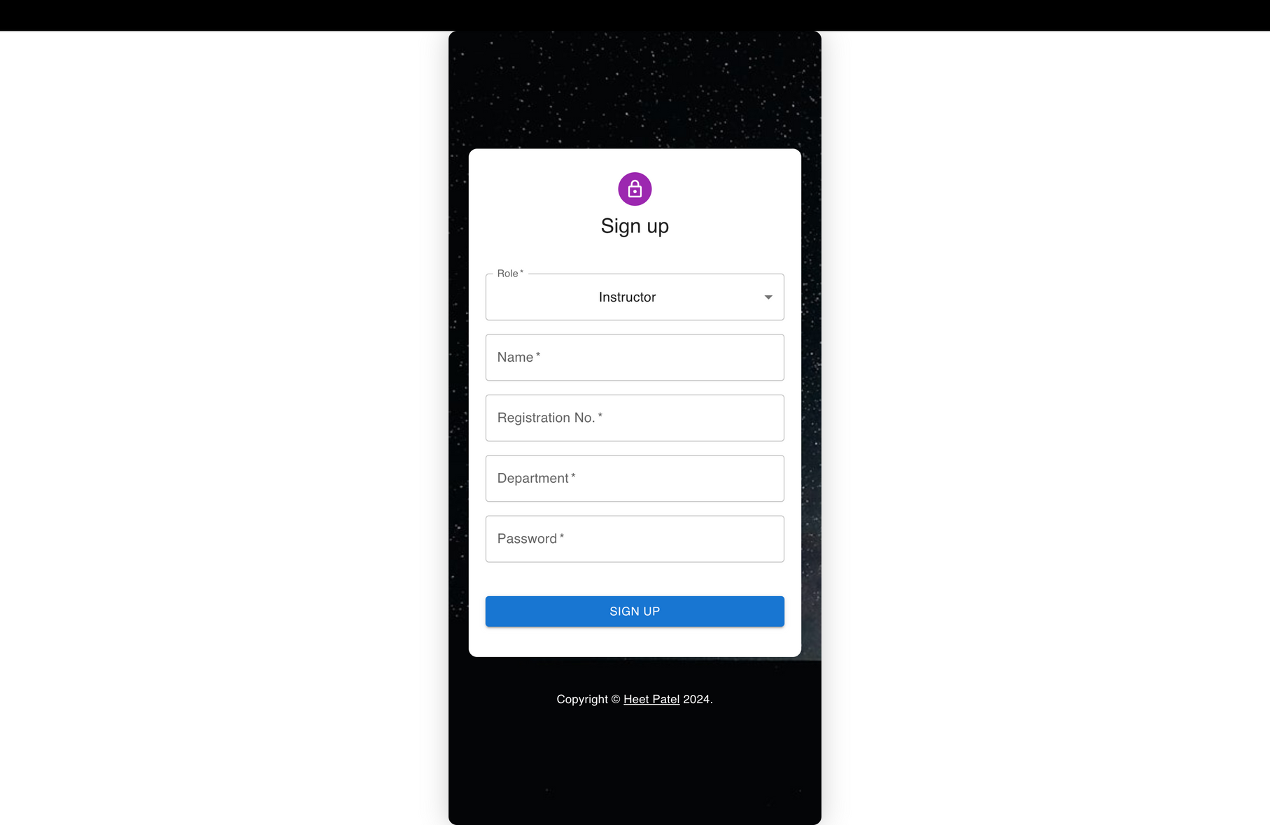
SIGN UP
Sign up pages for the student to register and the instructor to register themselves.

Slide 6

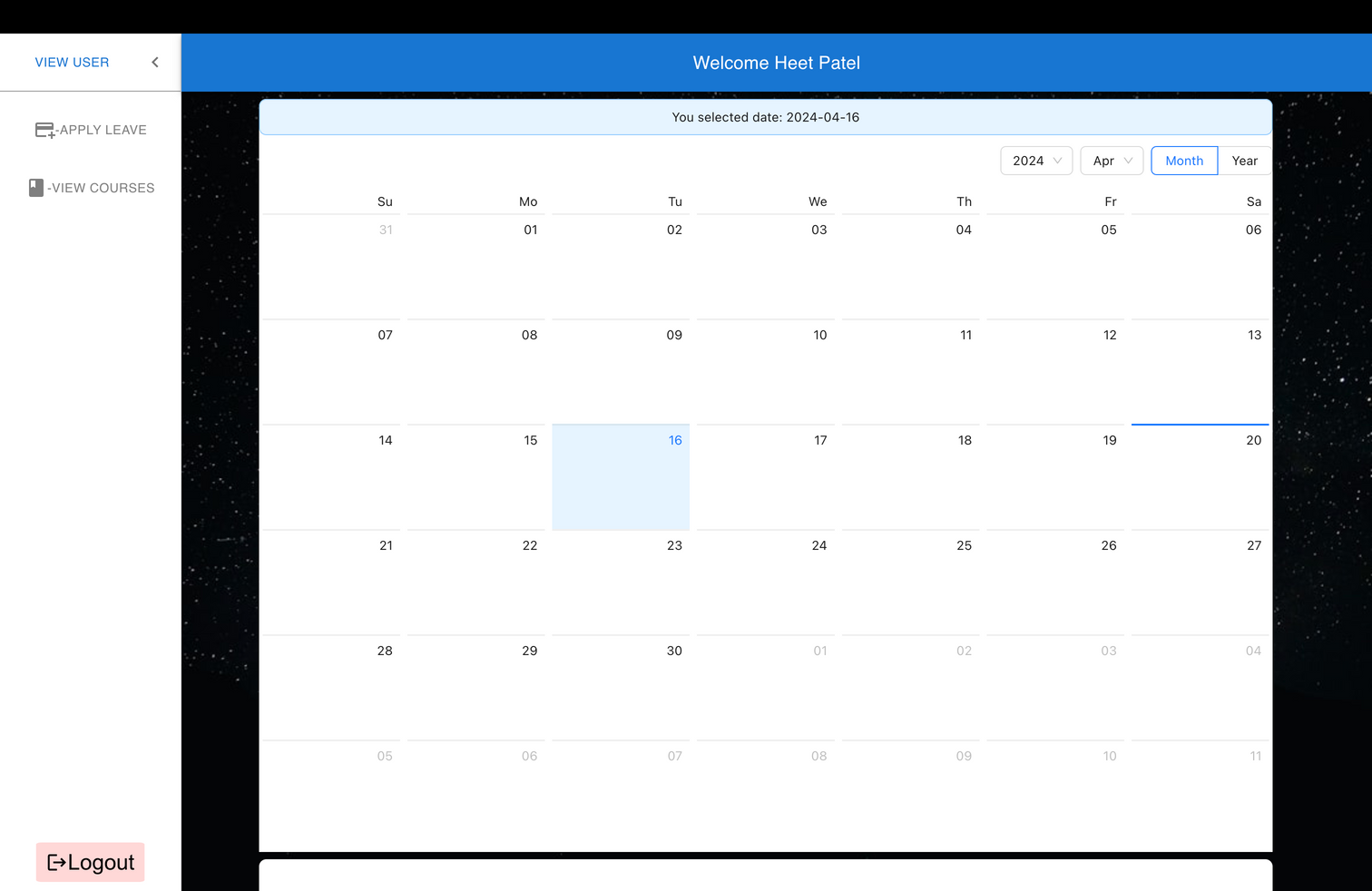
Student Dashboard

Slide 7

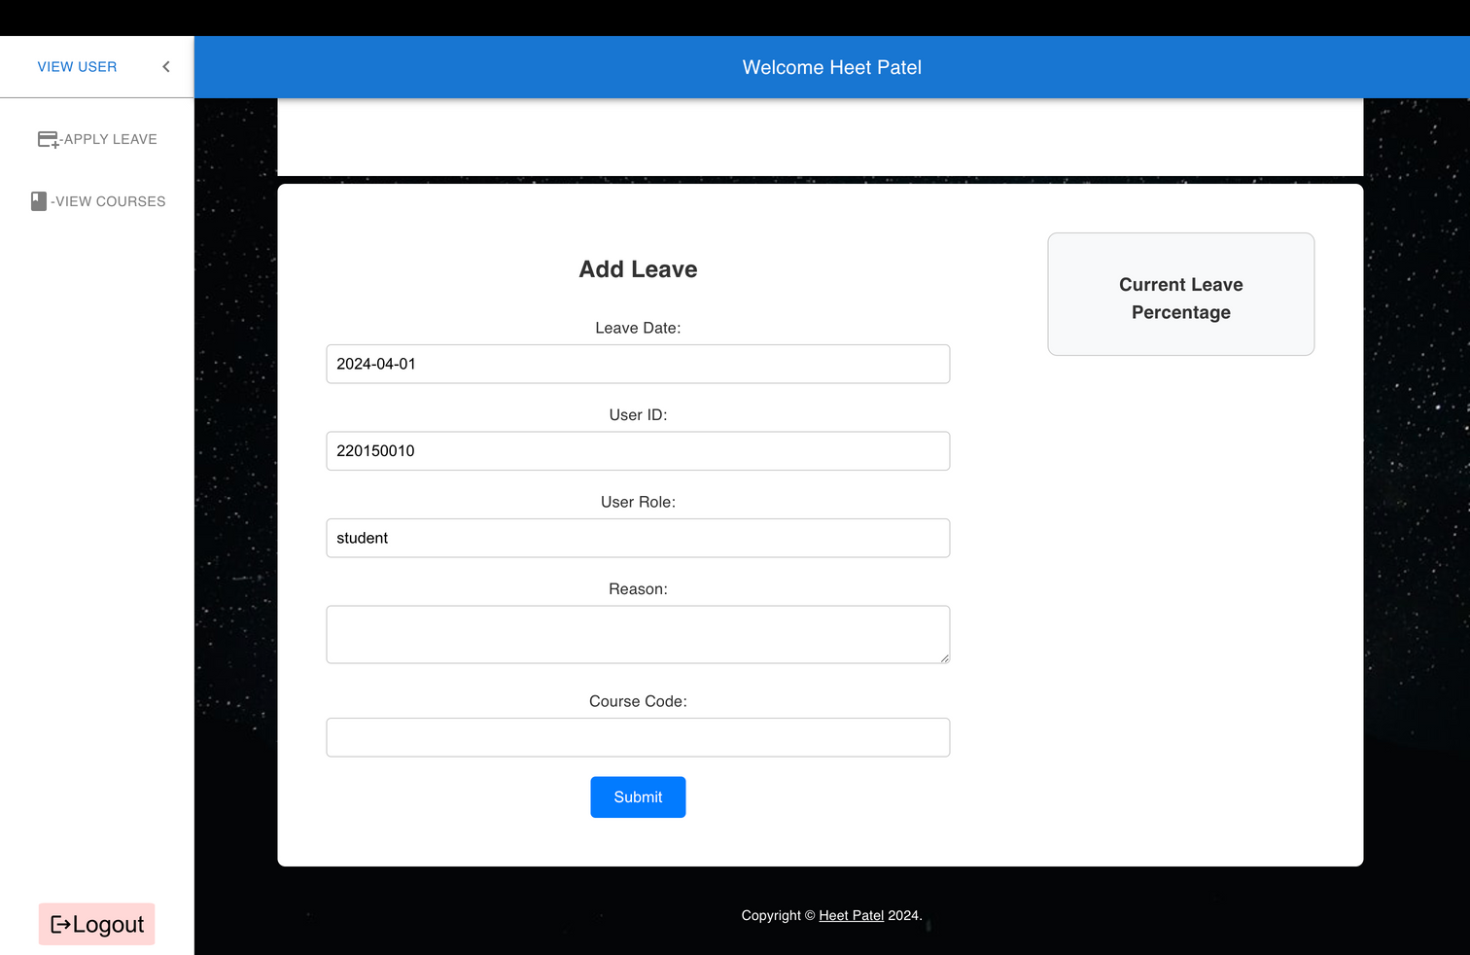
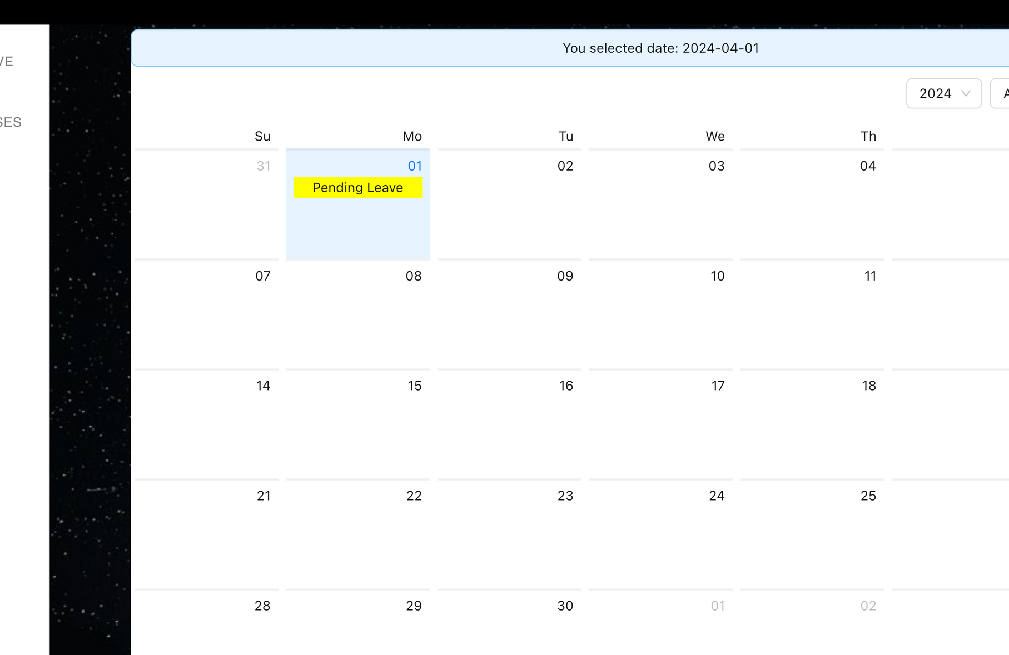
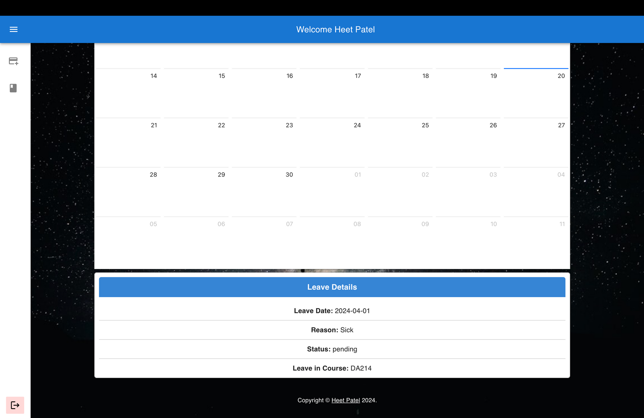
Student Dashboard...
In the student dashboard, you can select a date in the calendar provided and apply for leaves through the apply leave area. Scroll down to find the apply leave area.
The date is automatically selected from the calendar. Also, when you have applies for leaves in courses, they appear under Current Leave Percentage. Once you apply for a leave, the date turns pending. Also the apply leave area now shows the leave details on the selected date.

Slide 8
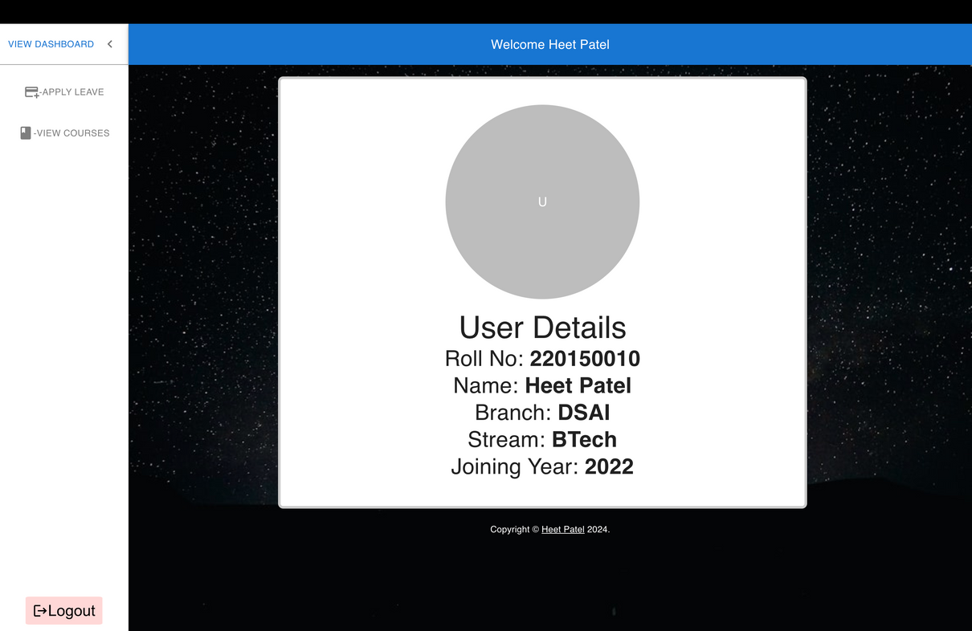
Student Dashboard...
On clicking the view user option on the top right, you can see the user details.
Also there is a view courses option in the sidebar which when clicked shows all the courses the student is registered into.

Slide 9

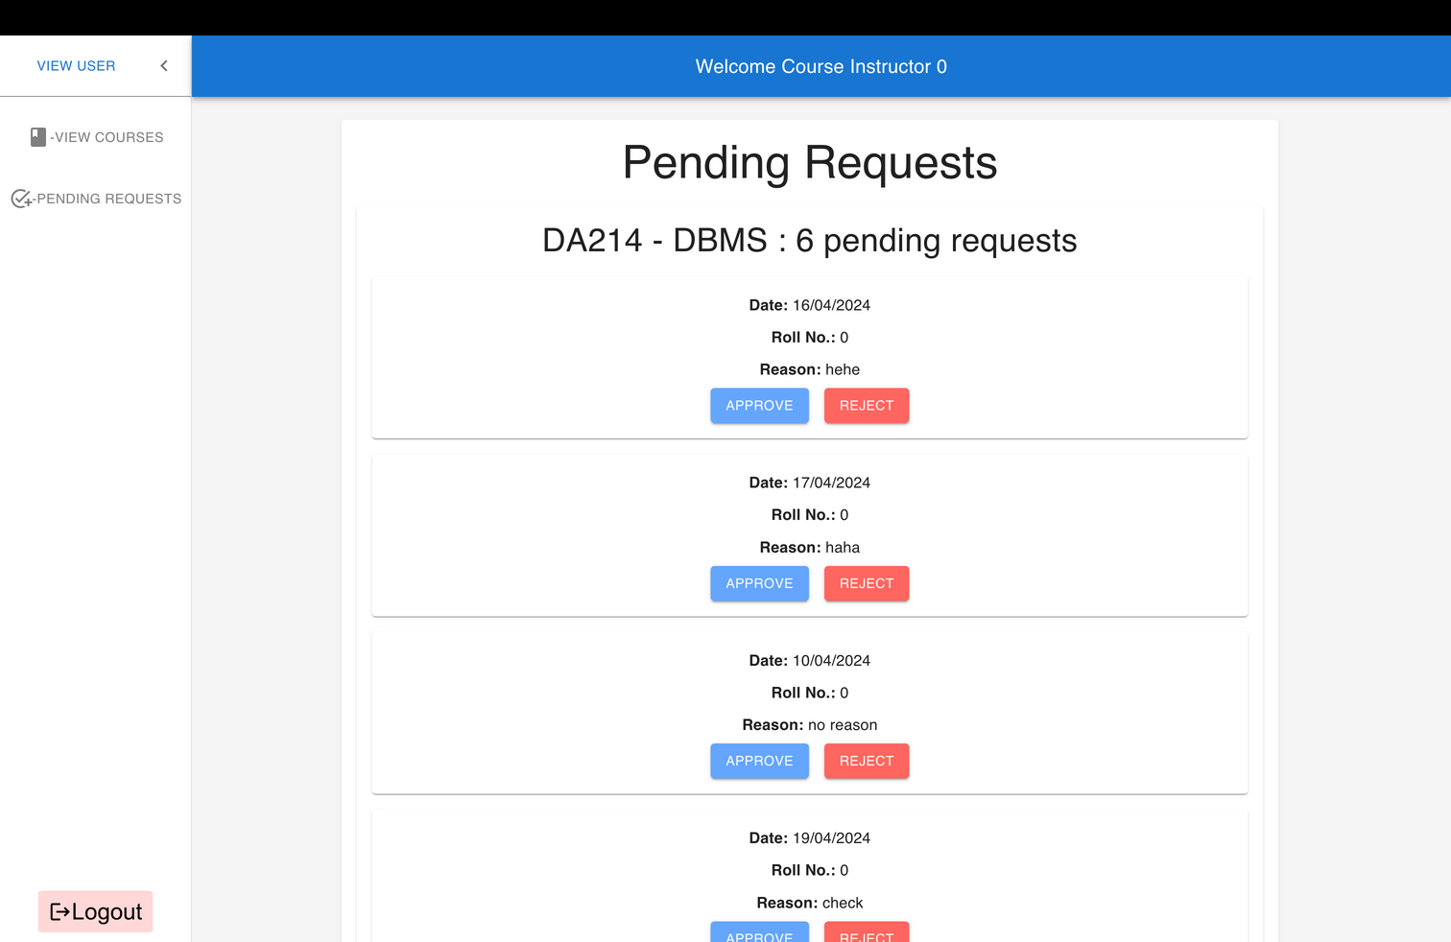
Instructor Dashboard

Slide 10

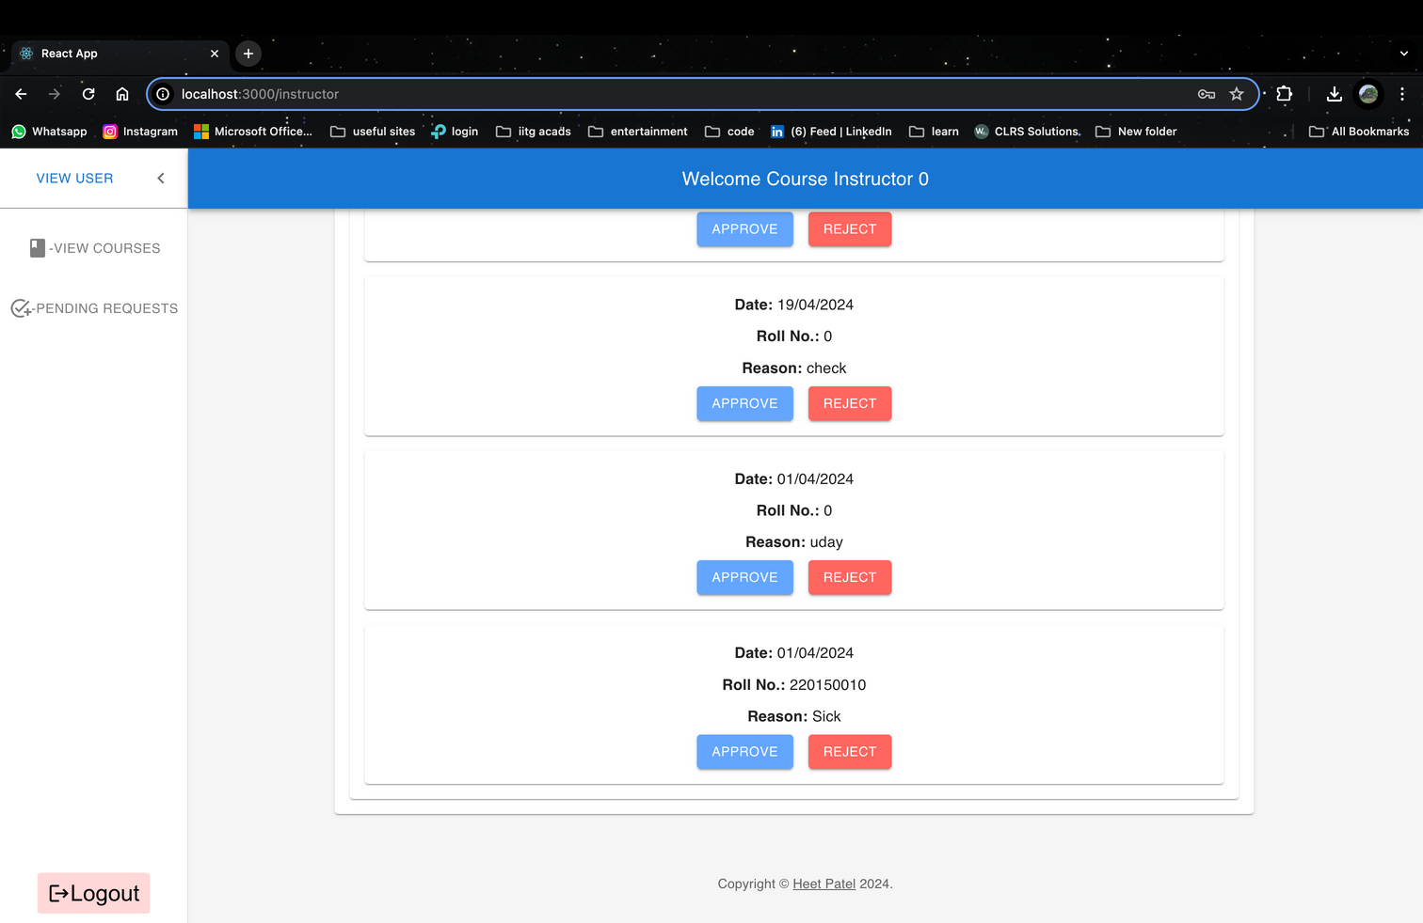
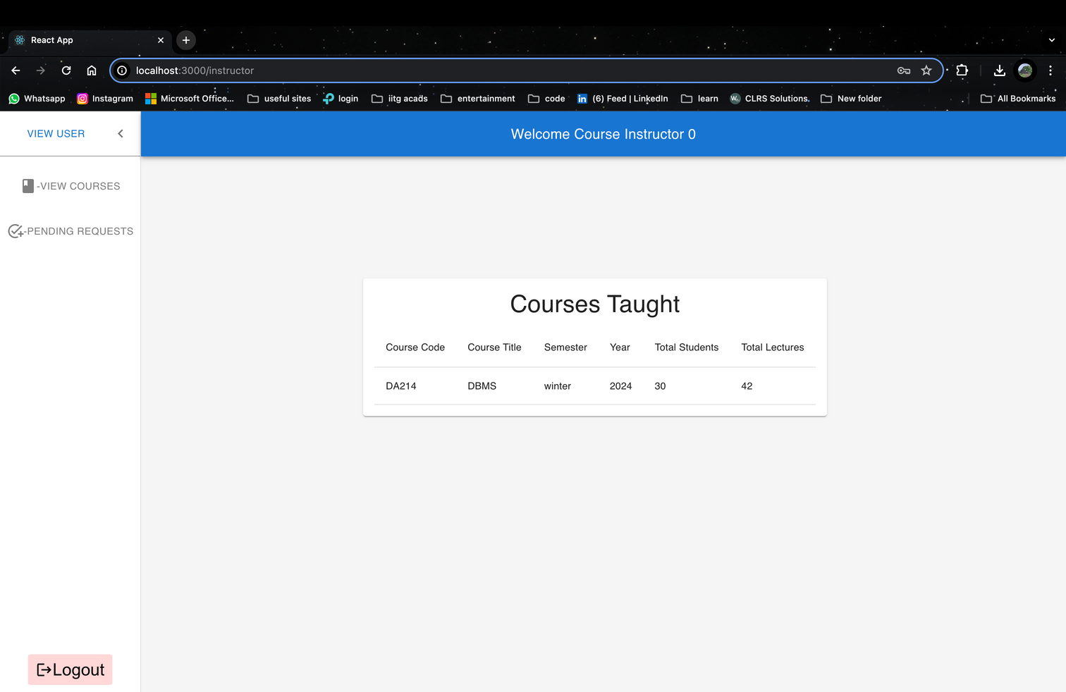
Instructor Dashboard...
The instructor dashboard has a pending leaves section which displays all the leaves that are in pending status waiting to be approved or rejected.
Here the instructor can approve or reject a leave which will be reflected in the student’s dashboard calendar as the pending tag changes to the new status.
Also the view courses button in the sidebar takes you to the courses taught section where all the courses taught by the instructor are displayed.
View user button displays user details.

Slide 11

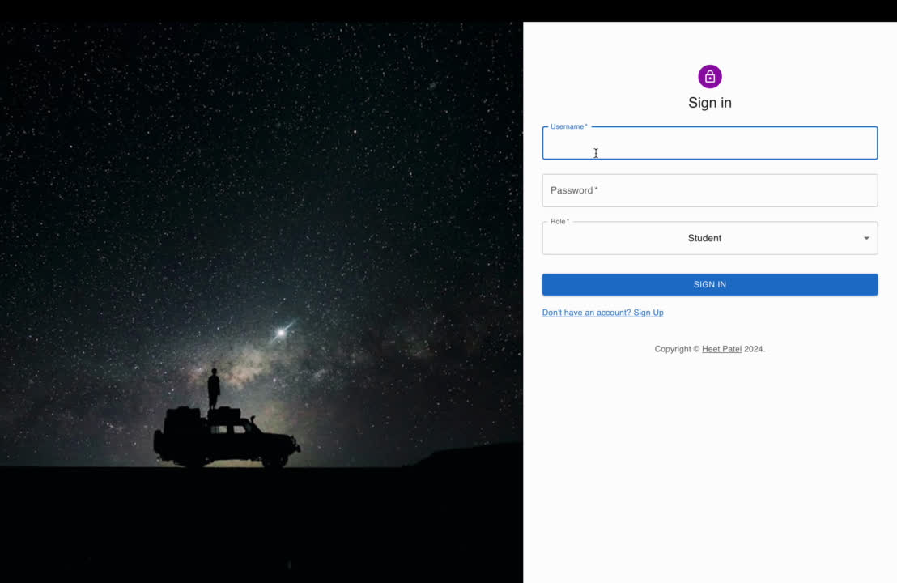
Click the video to play it.
This is a demo of student side of the website. I have applied for a leave using the username 0 and reason ‘Demo’.
In the next slide I’ll approve the leave and then again show the student side.
STUDENT SIDE DEMO

Slide 12

Click the video to play it.
Here I accept the request that I had made in the previous video.
In the next slide I have attached a screenshot of user 0's dashboard with the newly approved leave visible.
INSTRUCTOR SIDE DEMO

Slide 13
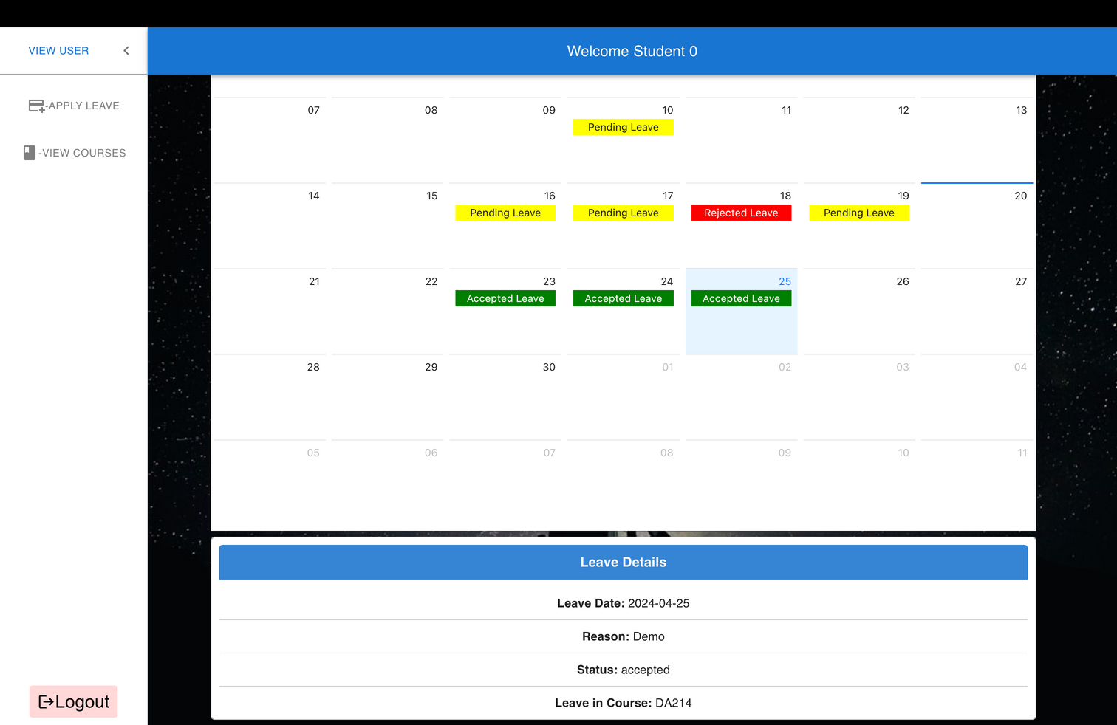
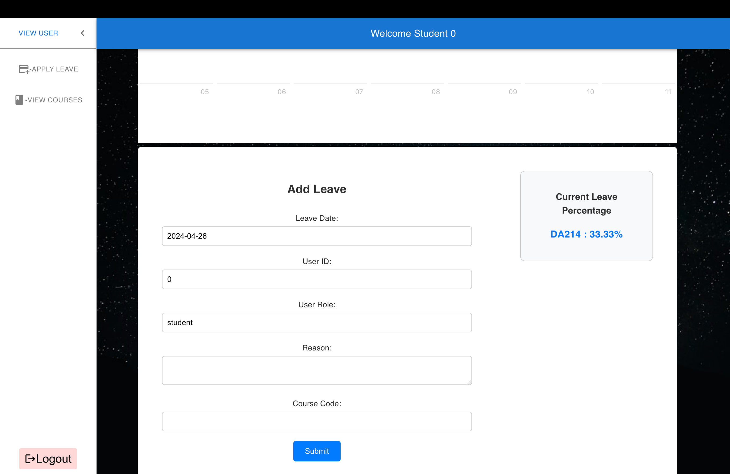
DEMO...
As you can see, the leave status is updated and the leave details are visible where status is accepted. Also current leave percentage gets updated too as I have set a trigger in the backend that calculates the leave percentage.

Slide 14

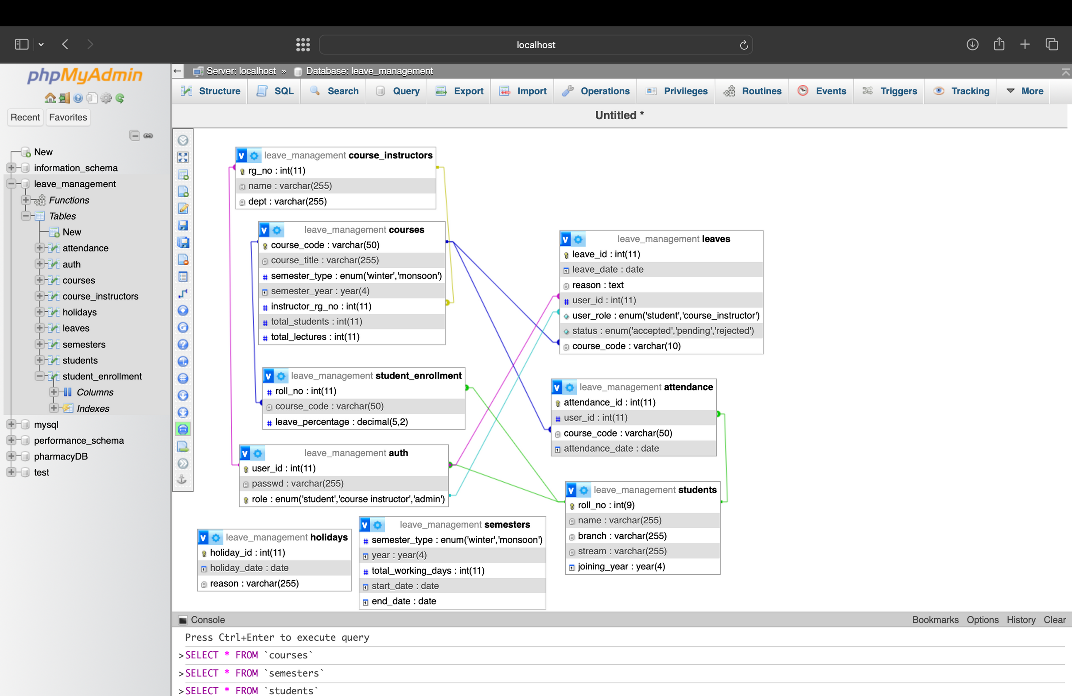
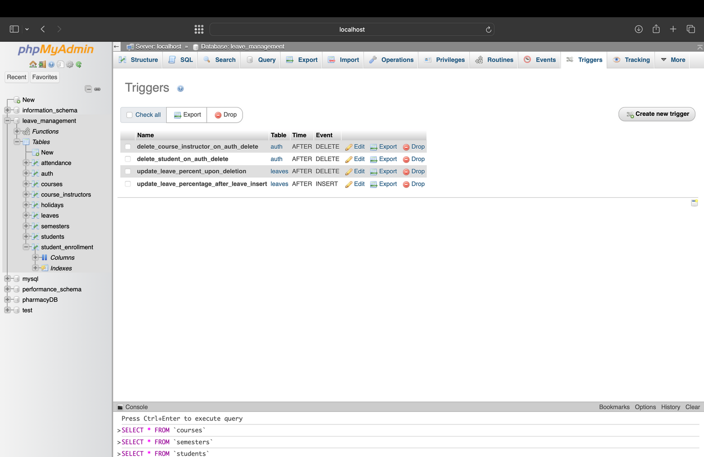
DATABASE DESIGN
Here is the database design for the website. It uses a mySQL database on XAMPP’s server.
I have also created some triggers to tackle data change which are shown below

Slide 15
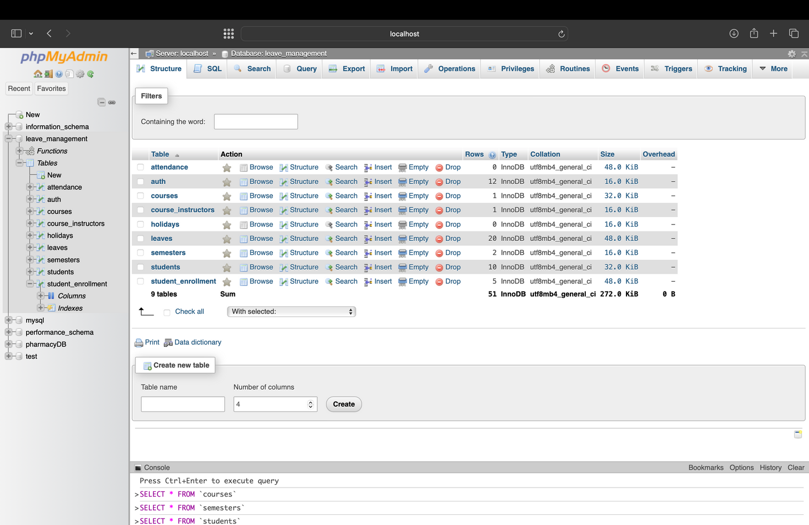
DATABASE DESIGN
Here are the tables I created for the database.
The auth table is used to verify users. The holiday table to get the days which are holidays so leaves cannot be placed then and the semesters table gives details about the semester.
Rest all of them represent entities which give functionality to the website.

Slide 16
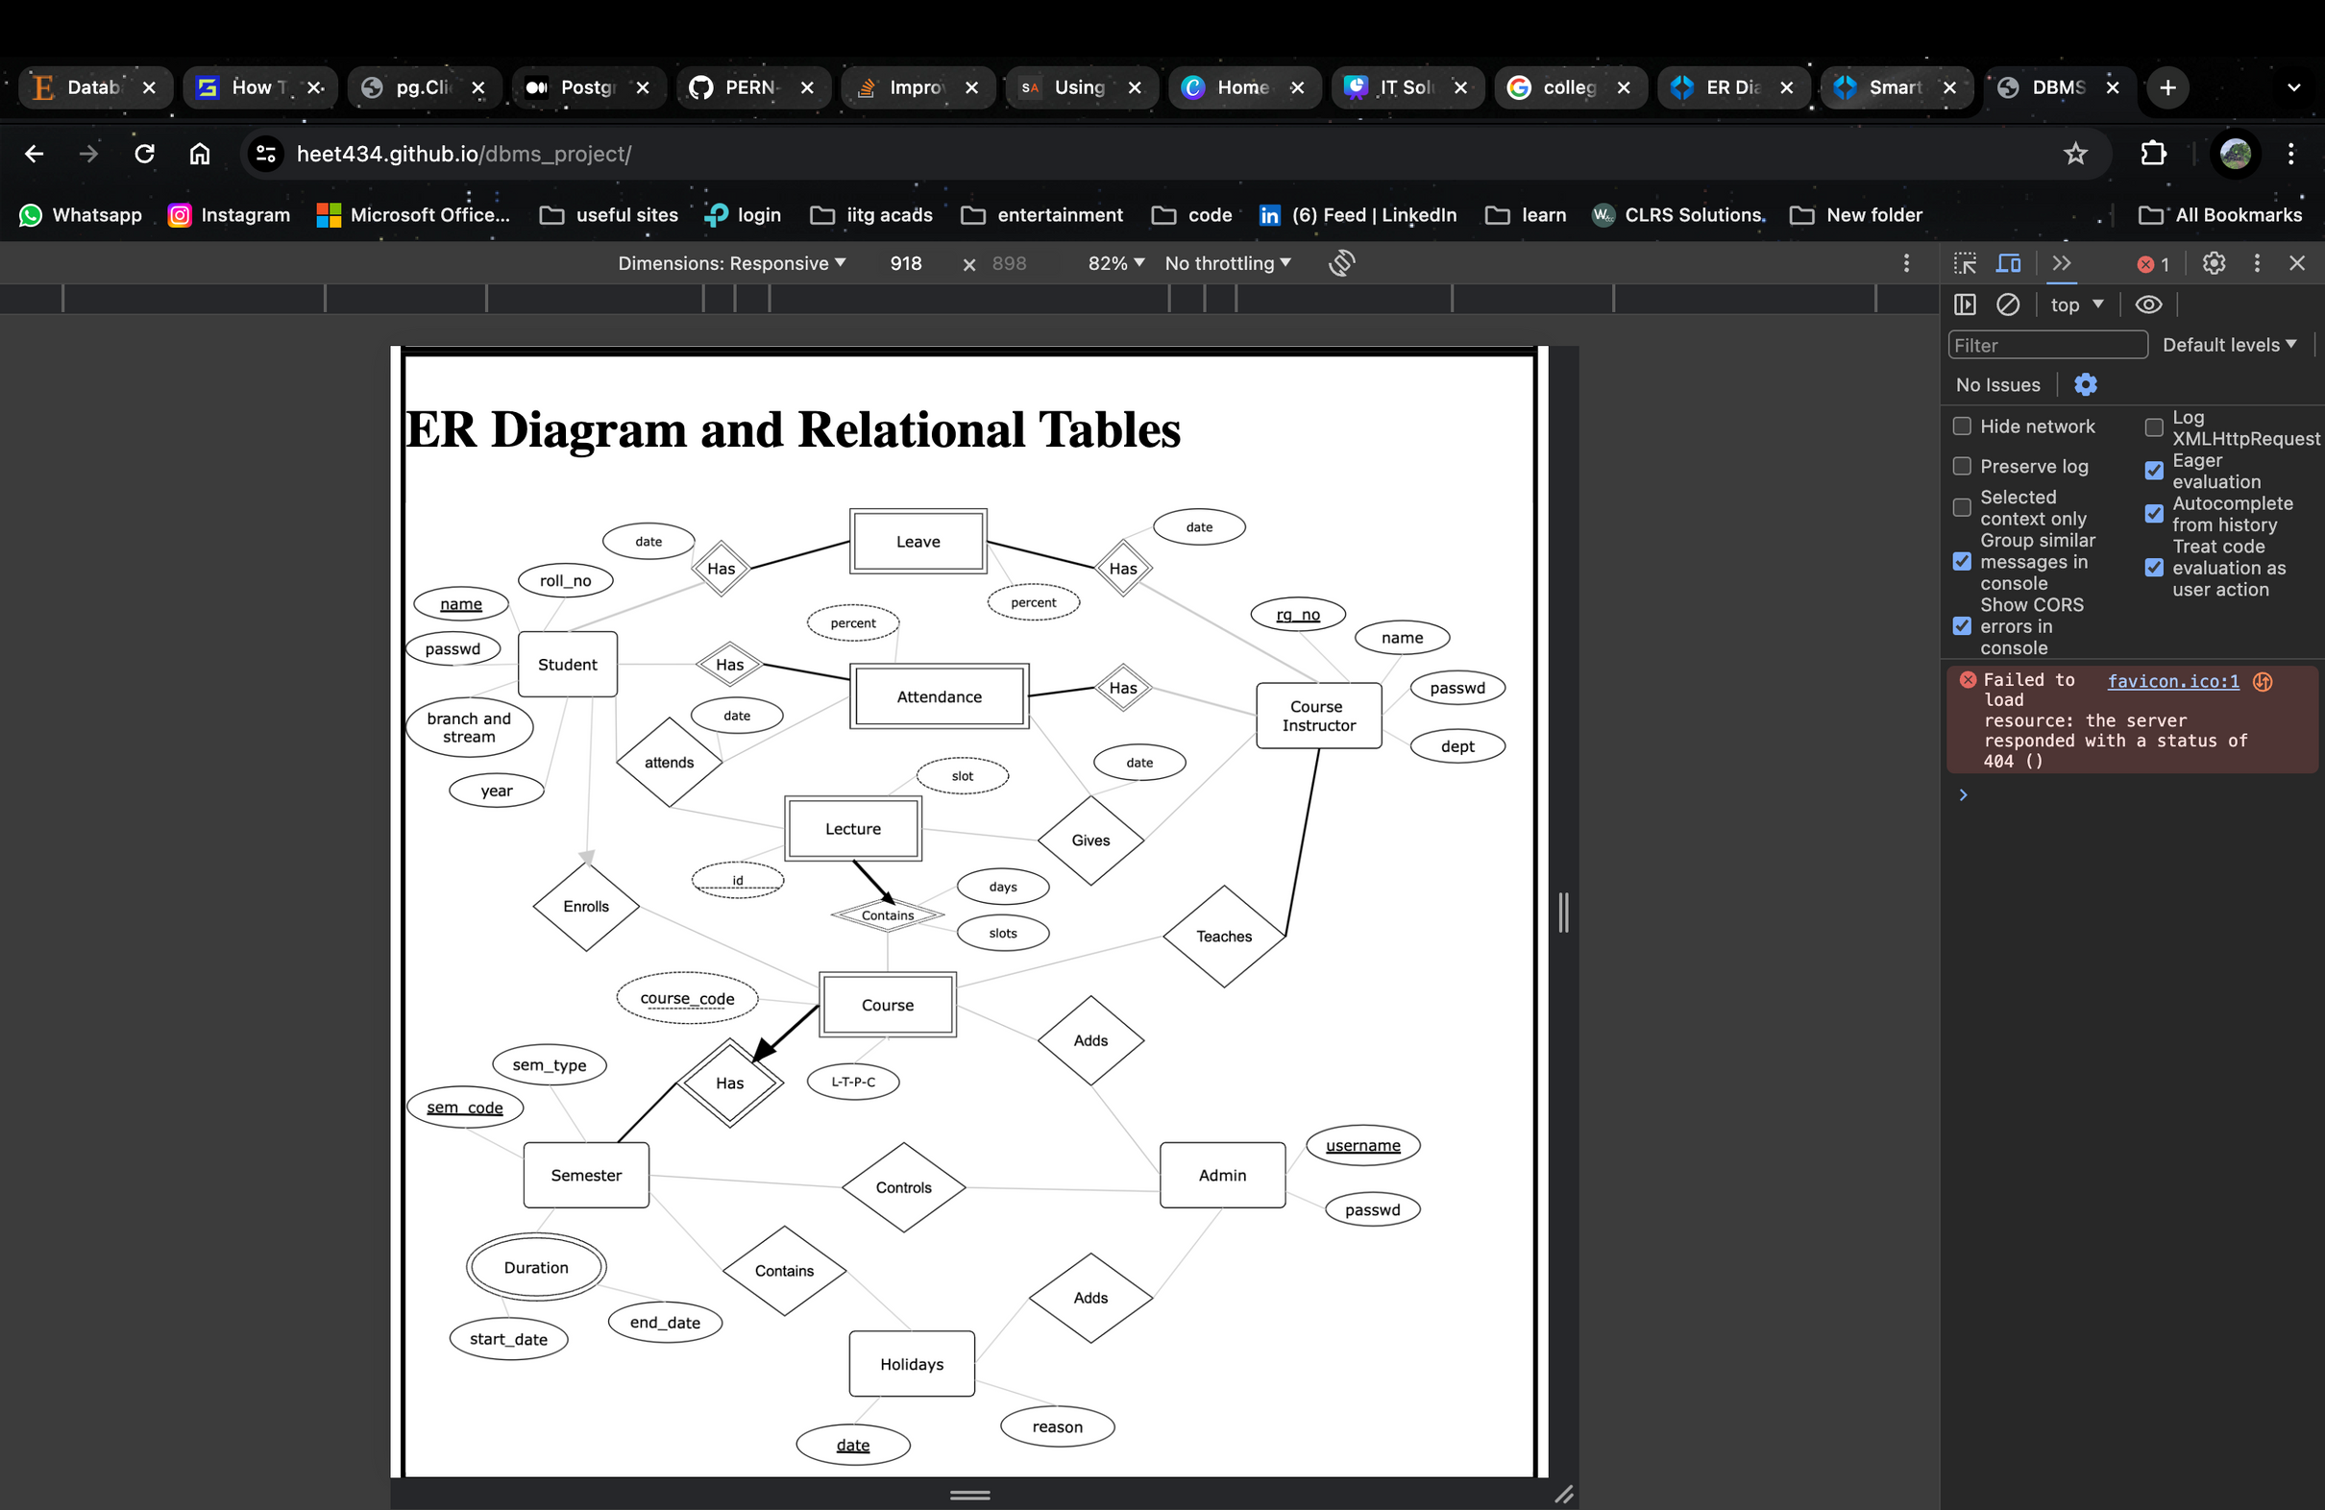
ER
DIAGRAM
This is my originally proposed ER Diagram of the database.
While I followed this diagram quite a lot, there are some things I did not add because they deviated from the core functionality of the website.

Slide 17

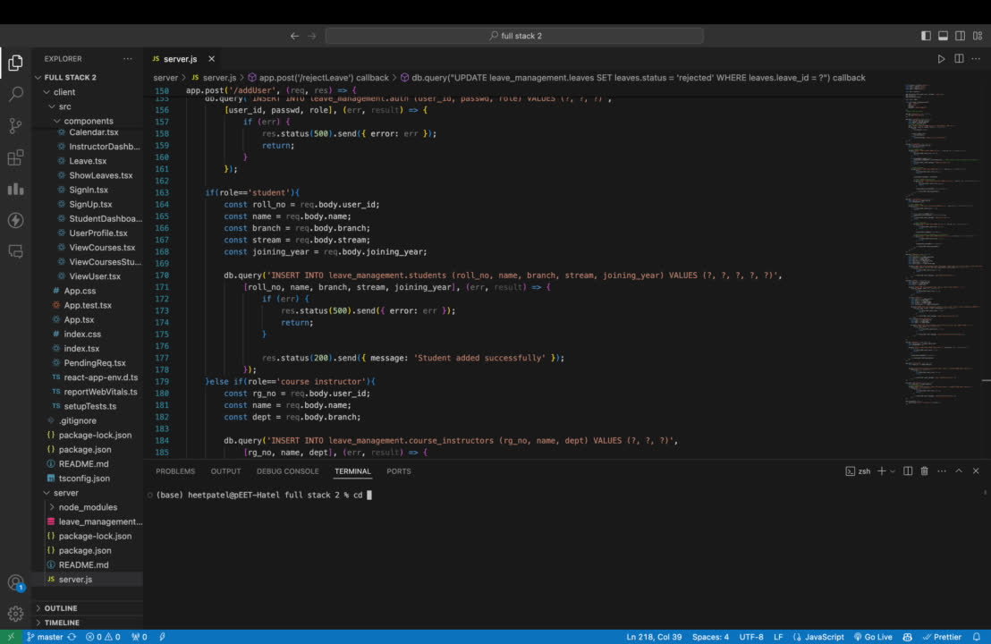
If you have installed the code, start the XAMPP server and use the sql file in the code to create the database and schema.
After that, go to the terminal inside the folder and do the following as in the video:
HOW
TO
START
THE
SITE
This will first start the server and then start the website on your localhost.

Slide 18

,
THINGS
LEARNT
AND STACKS USED
With this project, I learnt how to implement the backend for websites and it also gave a refresher on SQL. I also learnt how to use MaterialUI and AntDesign for making quick frontend components.
Key stacks that were used in this project include React, Express, Node and a MySQL database. Also, Axios was used for api fetching, Cors for cross origin resource sharing and some other helpful libraries.
THANK YOU

